Slide 1

Soccer betting simulation: optimizing long-term profit
BY Joe Omatoi

Slide 2
Overview
A betting simulation on over 8000 games was implemented.
Three strategies were analyzed and compared:
Arbitrage betting
Positive EV betting
ML-based betting
​The goal is to assess general profitability and the best method for long-term profit
Notes:
bet on all outcomes when profit is greater than or equal to 0 no matter the outcome
bet when expected value is greater than 0
bet according to machine learning predictions

Slide 3
Raw data
Data for 8264 league matches in the top 5 European football leagues in the 2019-2020, 2020-2021, and 2021-2022 seasons:
Fixture data (Sports Reference)
date, result, home team, away team, attendance, venue, league, referee, goals home, goals away
Odds data (Football-Data.co.uk)
market maximum, market average, and 6 bookmaker odds (home draw, away)

Slide 4
Processed data
date | result | home | away | b365h | b365d | b365a | max_h | max_d | max_a | avg_h | avg_d | avg_a
2019-08-09 | A | Monaco | Lyon | 3.00 | 3.3 | 2.37 | 3.0 | 3.60 | 2.52 | 2.89 | 3.40 | 2.43
2019-08-10 | A | West Ham | Manchester City | 12.00 | 6.5 | 1.22 | 13.0 | 6.75 | 1.29 | 11.84 | 6.28 | 1.25
2019-08-10 | H | Burnley | Southampton | 2.62 | 3.2 | 2.75 | 2.8 | 3.33 | 2.85 | 2.68 | 3.22 | 2.78
Notes:
only bet365 odds are shown and the odds of other 5 bookmakers are omitted because of space

Slide 5
1) Arbitrage betting: formulas
Spot arbitrage opportunity:
$$1/odds_{h}+1/odds_{d}+1/odds_{a}<1$$
Required wager amount to ensure risk free bet:
$$wager_{h}=wager_{t}/\left(1+\left(odds_{h}/odds_{d}\right)+\left(odds_{h}/odds_{a}\right)\right)$$
$$wager_{d}=wager_{t}/\left(1+\left(odds_{d}/odds_{h}\right)+\left(odds_{d}/odds_{a}\right)\right)$$
$$wager_{a}=wager_{t}/\left(1+\left(odds_{a}/odds_{h}\right)+\left(odds_{a}/odds_{d}\right)\right)$$

Slide 6
1) Arbitrage betting: calculation
date | wager_h | wager_d | wager_a | wager_total | compounded_profit | compounded_cum_profit
2019-08-10 | 100.65 | 116.36 | 183.00 | 400 | NA | NA
2019-08-16 | 327.32 | 49.30 | 23.38 | 400 | 9.2142435 | 11.80581
2019-08-16 | 258.30 | 86.10 | 55.61 | 400 | 0.3716568 | 12.17746
2019-08-17 | 320.42 | 56.02 | 23.56 | 400 | 0.5622537 | 12.73972
2019-08-17 | 75.93 | 91.46 | 232.61 | 400 | 2.6577320 | 15.39745

Slide 7
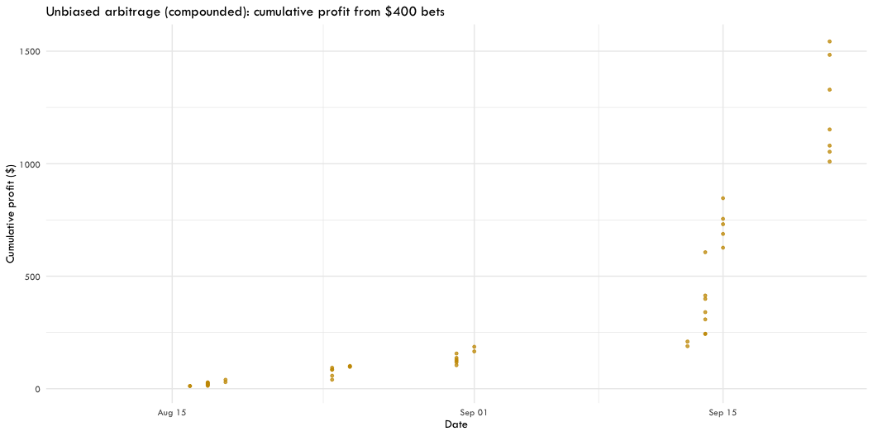
1) Arbitrage betting: simulation

Slide 8
1) Arbitrage betting: evaluation
Advantage: guaranteed and compounded profit
Disadvantage: not allowed for long (usually get banned)

Slide 9
2) Positive EV betting: formulas
$$EV_{h}=10\left(odds_{h}−1\right)p_{h}+\left(−10\right)\left(1−p_{h}\right)$$
$$EV_{d}=10\left(odds_{d}−1\right)p_{d}+\left(−10\right)\left(1−p_{d}\right)$$
$$EV_{a}=10\left(odds_{a}−1\right)p_{a}+\left(−10\right)\left(1−p_{a}\right)$$
($p$ was calculated using its corresponding $odds_{\left(avg\right)}$, detailed calculation in source code)

Slide 10
2) Positive EV betting: calculation
date | ev_h | ev_d | ev_a | bet | wager | result | profit | cum_profit
2019-08-09 | -0.13 | 0.07 | -0.14 | D | 10 | A | -10 | -10
2019-08-10 | 0.52 | 0.30 | -0.11 | H | 10 | A | -10 | -20
2019-08-10 | 0.01 | -0.09 | -0.17 | H | 10 | H | 18 | -2
2019-08-10 | -0.12 | -0.16 | 0.35 | A | 10 | A | 36 | 34
2019-08-10 | -0.16 | -0.02 | 0.08 | A | 10 | D | -10 | 24

Slide 11
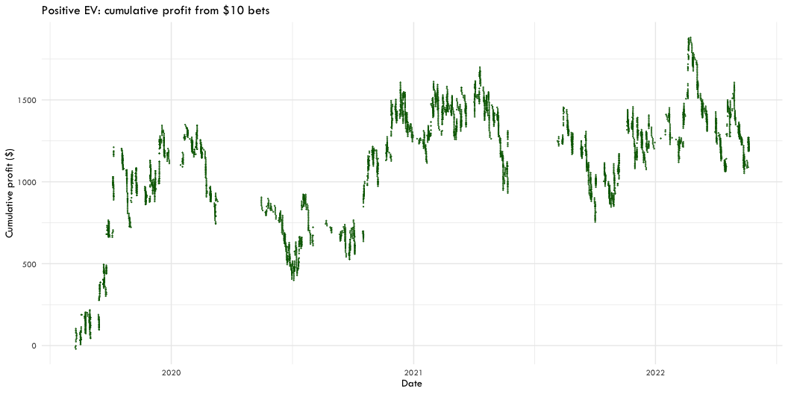
2) Positive EV betting: simulation
Notes:
Law of large numbers: in the long run, profits go above $0.
However, due to short-run fluctuations, many bets need to be placed to see results.

Slide 12
2) Positive EV betting: evaluation
Advantage: long-run profit
Disadvantage: short-run fluctuations require many bets and make big bets risky

Slide 13
3) Machine learning betting: training
Resampling
6612 games for training (80% of total)
V-fold cross validation with 5 folds and 5 repeats
Precision (true positives/total predicted positives) as performance measure

Slide 14
3) Machine learning betting: training
Models
Random forest
Boosted trees
Elastic net
Nearest neighbors
Predictors
PCA on all 6 bookmakers’ odds
Notes:
V-fold cross validation: Although the general recommended number of folds is 10, a lower value was chosen to allow a greater proportion of the dataset to be used for assessment in each fold. There are only 6462 observations and about 44% of the outcomes are home wins: it is likely to only see predictions for home in each fold, and this scenario must be avoided to create a well-rounded model.
Precision: Maximizing precision minimizes false positives, which are unacceptable in betting
Models: Having a portfolio of multiple models with a good mix of flexible and inflexible models diversifies the risk of under/overfitting.
Predictors: a lot of fixtures data like attendance, week, league, mean of previous 5 home goals, away goals, home points, and away points were used, but odds contained far more information necessary to predict more precisely.

Slide 15
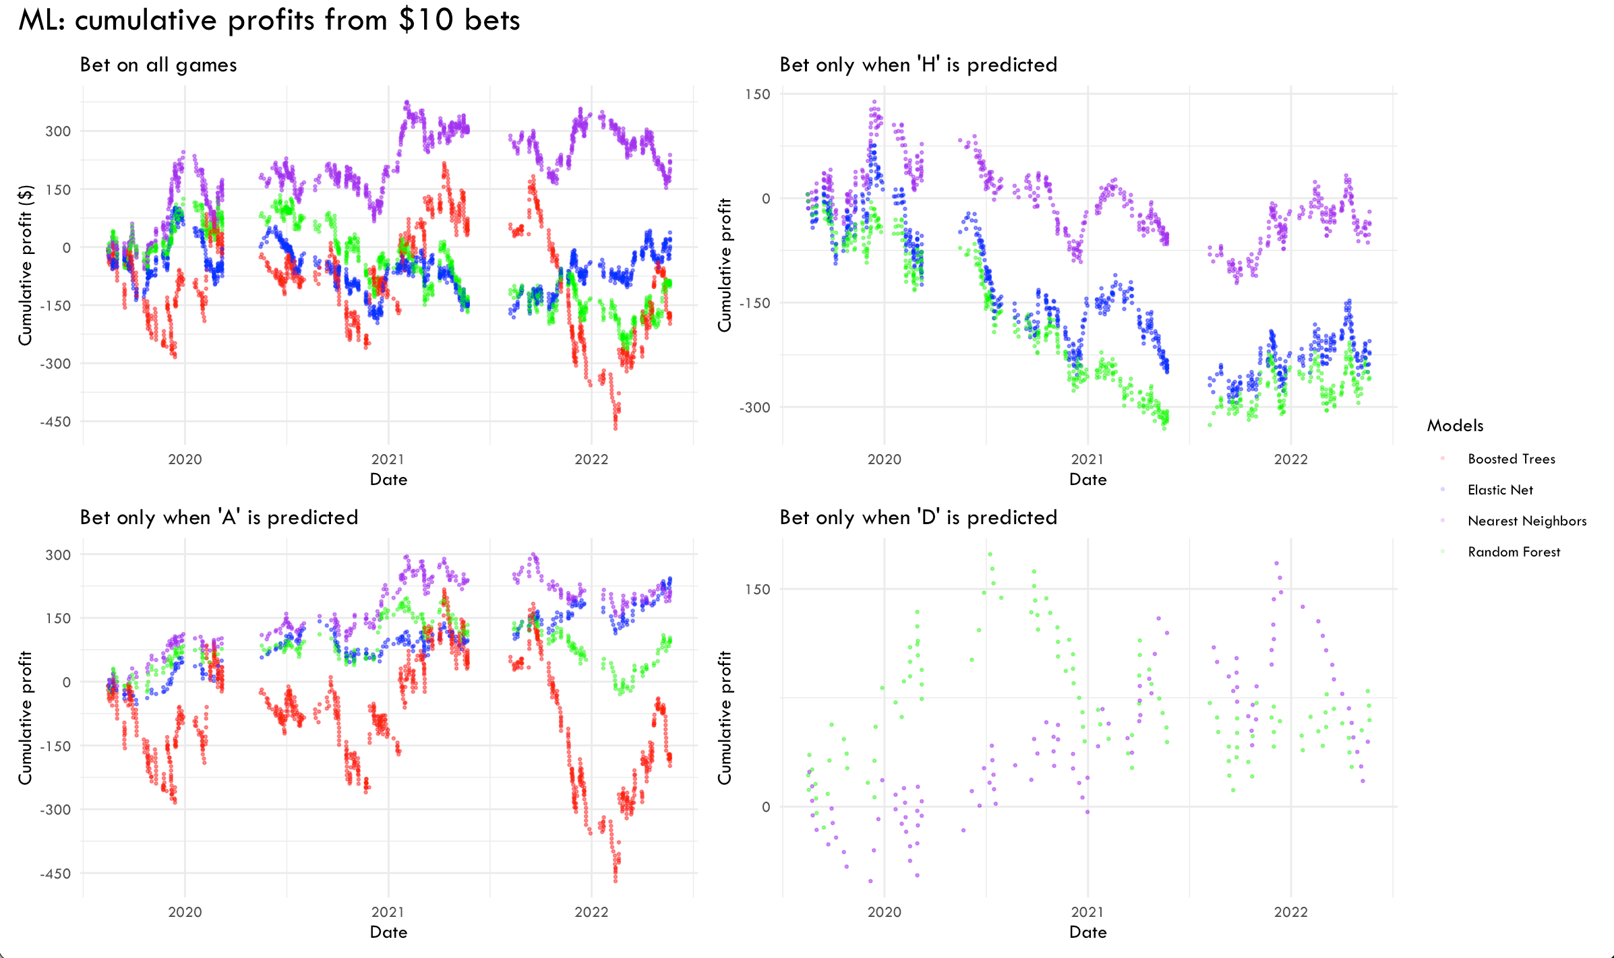
3) Machine learning betting: simulation

Slide 16
3) Machine learning betting: evaluation
Advantage: high profitability achieved with only betting when draw or away is predicted
Disadvantage: limited games to bet per season

Slide 17
Final comparison
Method | Estimated profit per season ($)* | Estimated Profit ($)* | Profit ($) | Number of bets
Random Forest (A&D) | 791.7621 | 2375.2863 | 290.3 | 436
Nearest Neighbors (A&D) | 702.3036 | 2106.9109 | 257.5 | 431
Positive EV | 661.4419 | 1984.3258 | 1191.7 | 4565
Nearest Neighbors | 649.3922 | 1948.1766 | 238.1 | 1010
Elastic Net | 102.5500 | 307.6499 | 37.6 | 1010
Random Forest | 59.7299 | 179.1897 | 21.9 | 1010
Boosted Trees | -540.0238 | -1620.0713 | -198.0 | 1010
*profits of machine learning methods are multiplied by 8264/1010 since only 1010 games were available (testing data was 20% of the total and not all games had market max/avg odds)
*profit of the positive ev method is multiplied by 8264/4963 since only 4963 games had market max/avg odds.
Notes:
profit per game would not be a good performance indicator since even if a method has a high profit per game, without the ability to bet on many games, total profit per season may not be high.

Slide 18
Thank you!
Access source code on my GitHub
Email me with questions and comments

